Slide 1
The Effects of Chain Architecture on Single-chain Polyelectrolyte Conformations
Takashi Yokokura
Wang Group Meeting
08/26/21

Slide 2



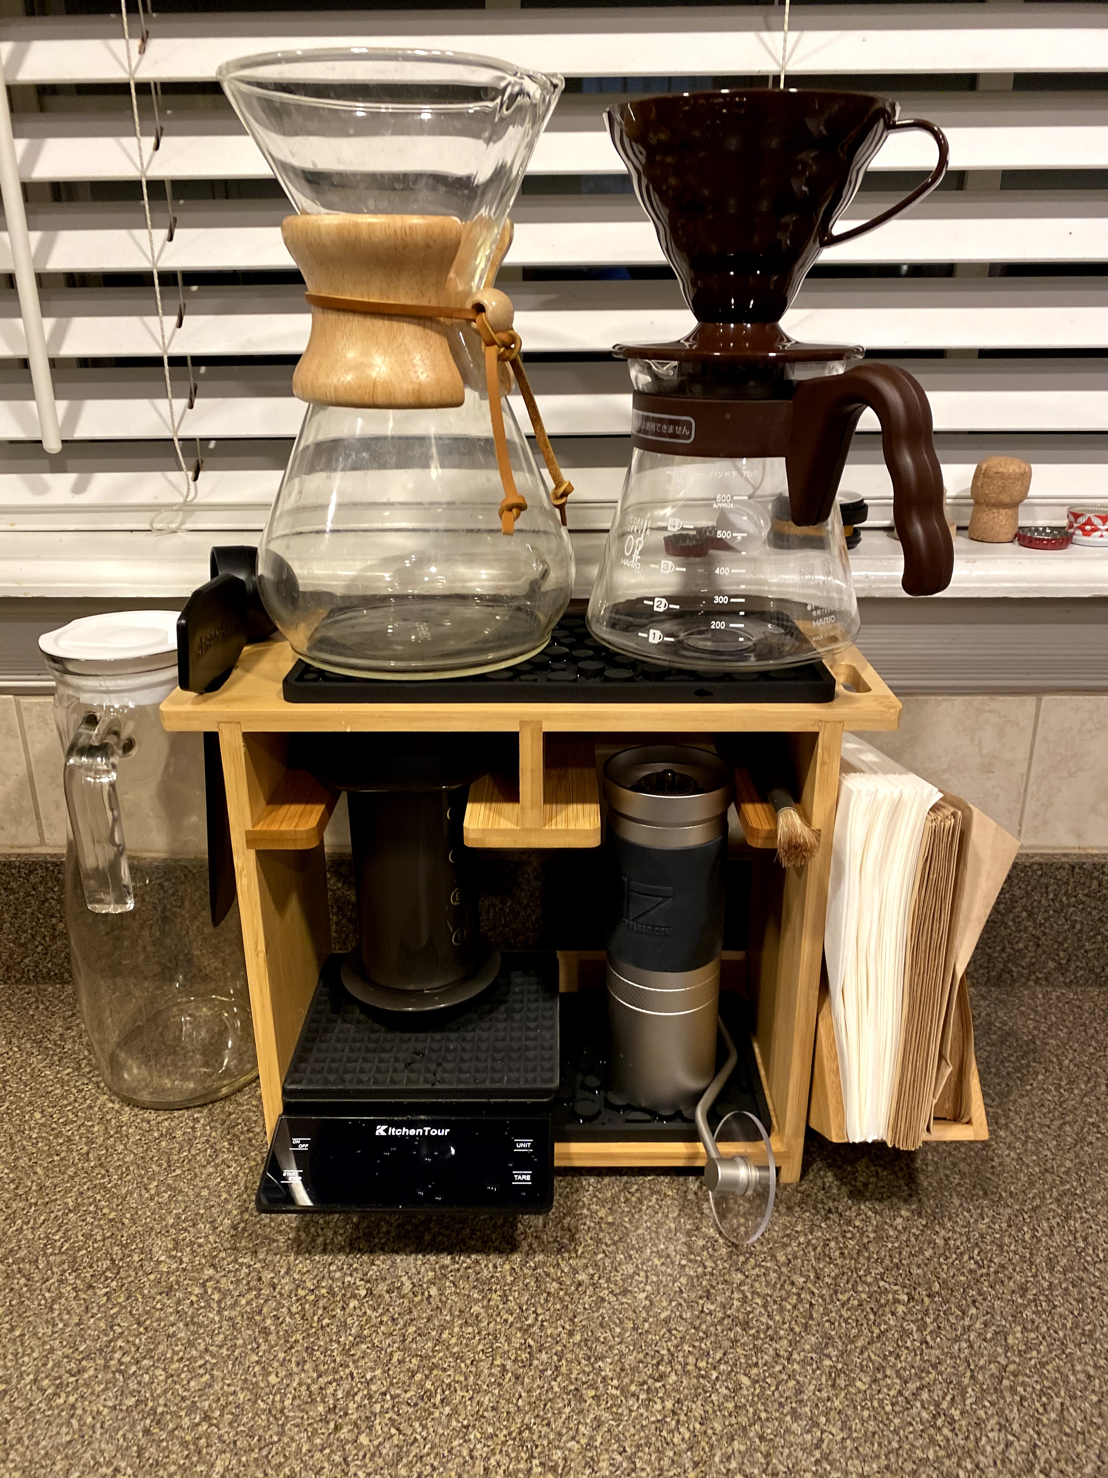
Takashi Intro
Purdue University, Class of 2020
Cyanobacteria (metabolic pathways)
Drug delivery (nanoparticles for breast cancer, IUCAC proposal)
Li-ion battery (carbon anodes from food waste)
Hobbies
Hiking, cooking, tennis, making/drinking coffee

Slide 3
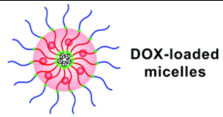
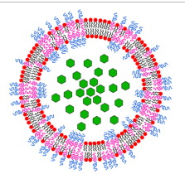
Wang Polyelectrolyte Subgroup
Overall motivations:
To understand polyelectrolyte (PE) behaviors using theories that are both rigorous and general
To solve difficult, real-world problems using these theories
i.e., protein folding and aggregation, drug delivery, phase separation
One key question:
What PE conformations are uniquely useful, and under what conditions do they manifest?
What experimentally accessible factors can be changed to induce desired conformations/conformational changes?
Hydrophilic drug encapsulated by block co-polymer
Hu, et al. 2015. Polym. Chem.
Khan, et al. 2020. Journal of Colloid and Interface Science

Slide 4
Project Overview
Interactions between chain architecture and charge distribution
Chain architecture:
Mesoscale organization of the chain in which chemical identities are unchanged (Rubenstein Ch 1)
Charge distribution
Moving charge fraction across the chain while maintaining constant cumulative charge
Subproject progression
Chao Framework
Linear Block
Star
Branched
(Linear homopolymer)
+ Charge Distribution
+ Simple Architecture
+ Complex Architecture

Slide 5
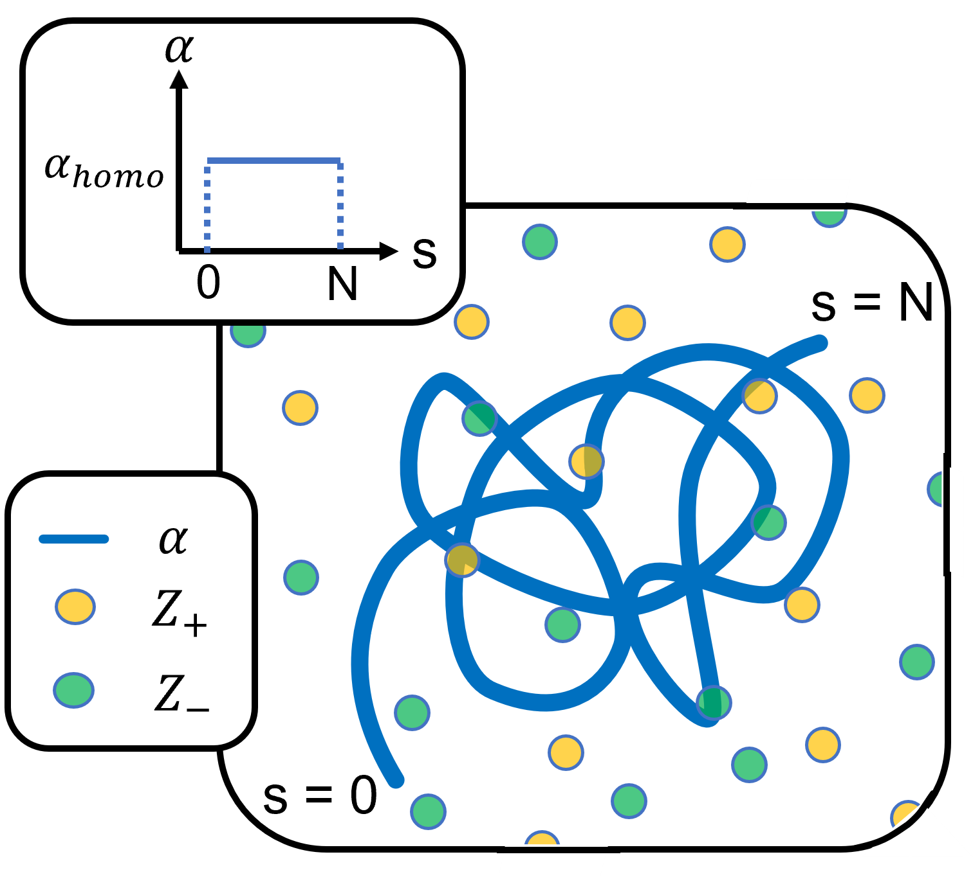



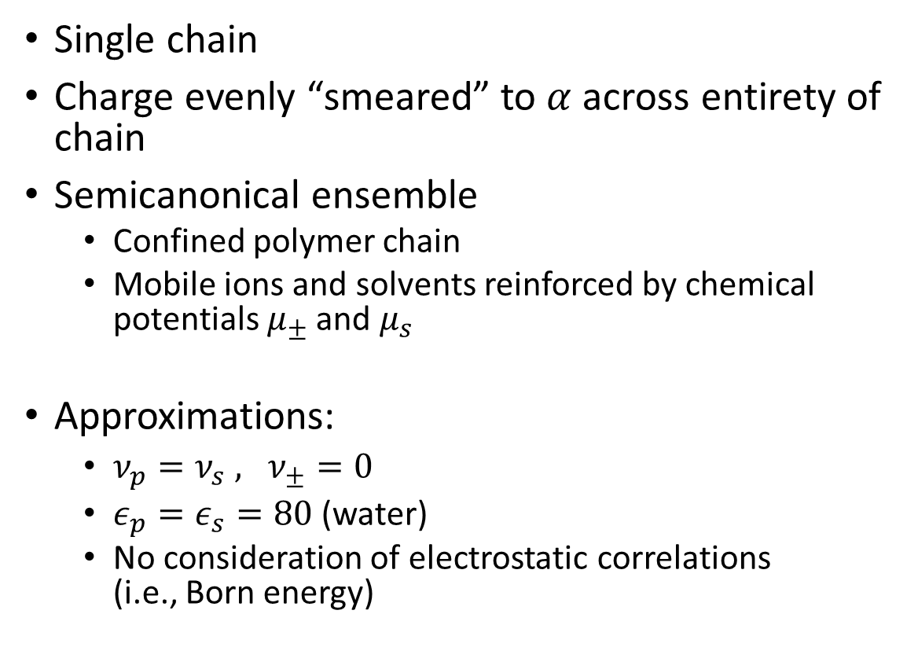
Model (Original PE Framework)
Single chain
Charge evenly “smeared” to $α$ across entirety of chain
Semicanonical ensemble
Confined polymer chain
Mobile ions and solvents reinforced by chemical potentials $μ_{±}$ and $μ_{s}$
Approximations:
$ν_{p}=ν_{s} , ν_{±}=0$
$ε_{p}=ε_{s}=80$ (water)
No consideration of electrostatic correlations (i.e., Born energy)
PN
Sph
Ves
Duan, Li, Wang. 2020. J Chem Phys

Slide 6
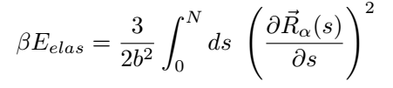
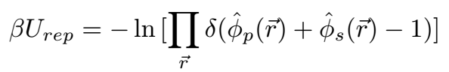
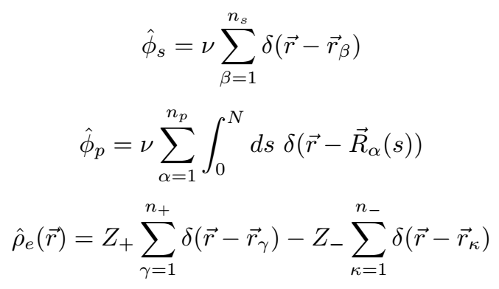
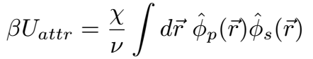
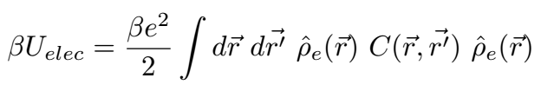
Interactions (Original PE Framework, cont.)
Continuous Gaussian Chain
Local incompressibility (excluded volume)
Flory Interactions
Electrostatic interactions

Slide 7
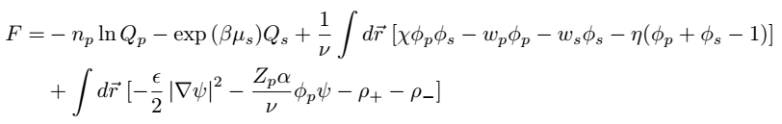
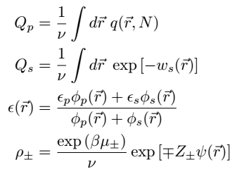
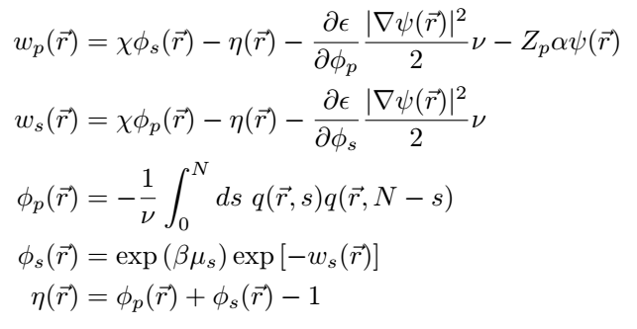
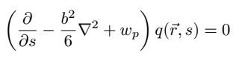
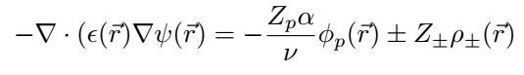
SCF Equations (Original PE Framework, cont.)
Free Energy:
SCF Equations:

Slide 8
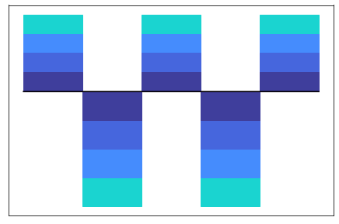
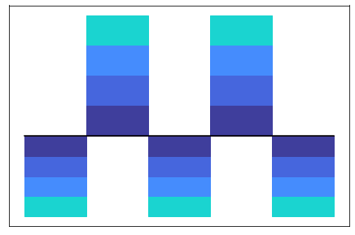
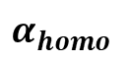
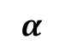
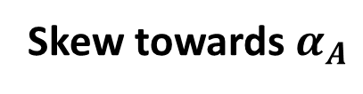
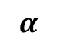
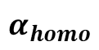
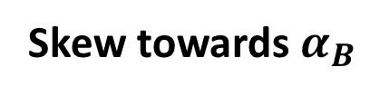
Subproject 1: Block copolymer
Model:
K number of chemically identical blocks
Constant total charge
Exploration of charge distribution
Hypothesis: vesicle more likely when pushing charge to ends
Skew towards $α_{A}$
K = 5
Skew towards $α_{B}$
$$α$$
$$α$$
B
B
A–B–A–B–A
$$α_{homo}$$
A
A
A
A
A
A
$$α_{homo}$$
B
B
0
0
0
N
0
N

Slide 9
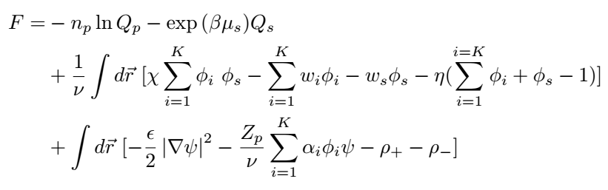
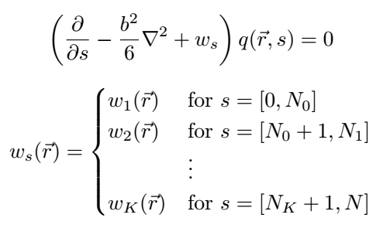
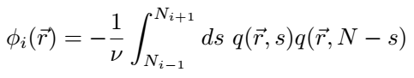
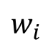

Changes to Framework
$α_{i}, φ_{i}, w_{i}$ for K number of blocks
$$w_{i}$$
, where
$$w_{i}$$
Sidenote: similar changes for other subprojects—matter of expressing each propagator to reflect the desired architecture ($α_{i}, φ_{i}, w_{i}$ for K blocks)

Slide 10
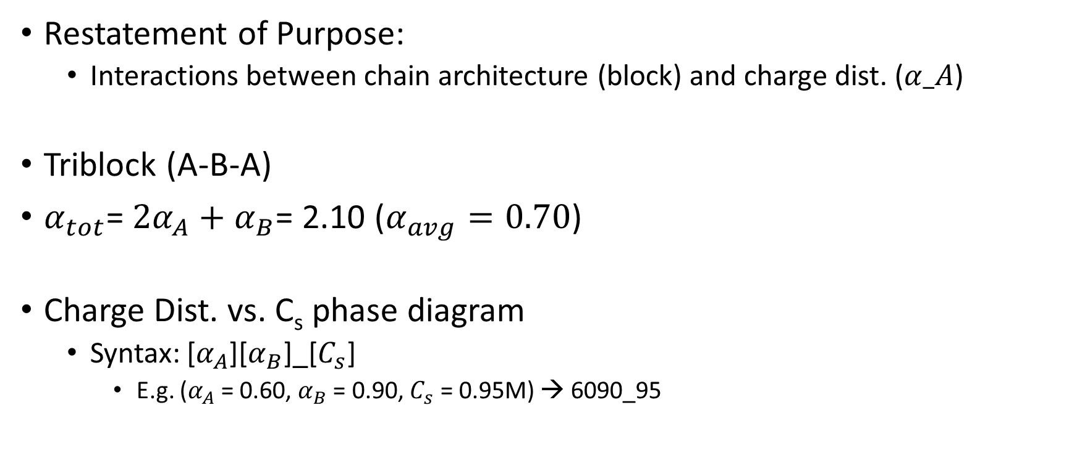
Phase Space of Interest
Restatement of Purpose:
Interactions between chain architecture (block) and charge dist. ($α_A$)
Triblock (A-B-A)
$α_{tot}$= $2α_{A}+α_{B}$= 2.10 ($α_{avg}=0.70$)
Charge Dist. vs. C_{s} phase diagram
Syntax: [$α_{A}$][$α_{B}$]_[$C_{s}$]
E.g. ($α_{A}$= 0.60, $α_{B}$ = 0.90, $C_{s}$ = 0.95M) → 6090_95

Slide 11
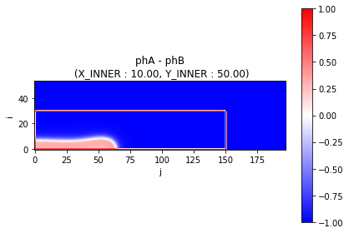
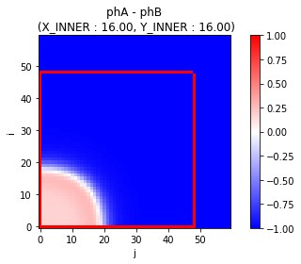
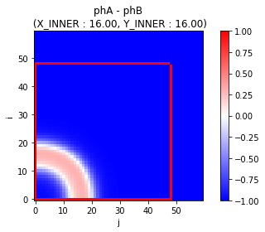
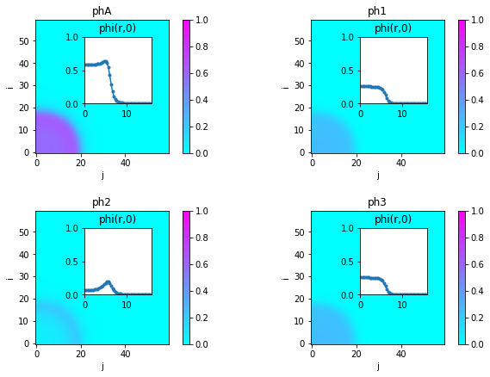
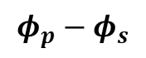

Demonstration of Triblock System
PE only
$$φ_{p}−φ_{s}$$
Sph, 6090_95
Ves, 6580_95
Solvent only
PN, 5894_88
$$φ_{i}$$

Slide 12
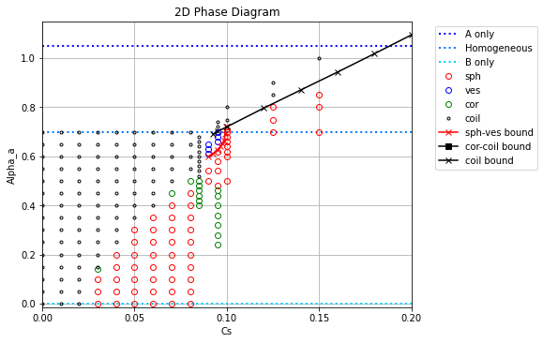
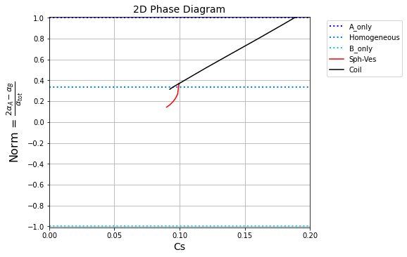
Hypothesis Validation

Slide 13
Future Steps
Finish Triblock phase diagram (only PN left) & check Ves homopolymer region
Preliminary exploration of phase space for triblock
Chain average charge
Negatively and Positively charged blocks (unlikely to give interesting results)
5-block: more interesting charge dist. (gradual increase, oscillating)
Subsequent subprojects
Star co-polymer
Backbone branched co-polymer
All future results similar procedure: change q(r,s) and corresponding fields
All optimizations and bulk processing subroutines carry over
Full project completion goal: End of 2021

Slide 14
Thank you!
Note: Please check your sections on the website (project, personal bio, publications, etc.) and let me know if you there are any changes that need to be done

Slide 15
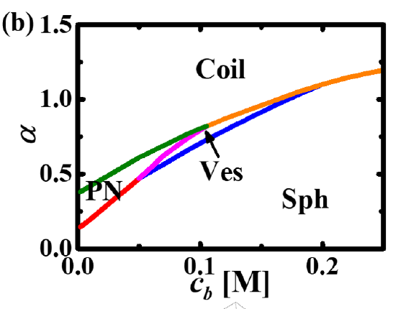
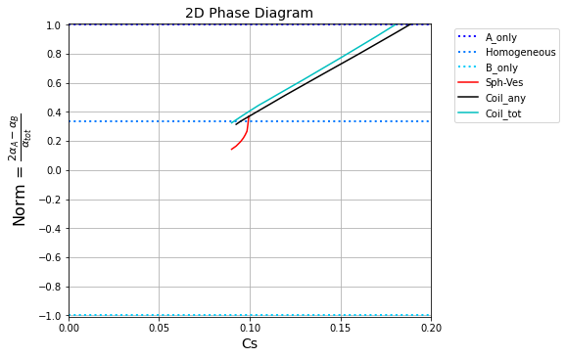
Comparison to Previous Results
To make phase diagram consistent with prev. results,
del_123 instead of del_any > 2.0e-03
Duan, Li, Wang. 2021. In progress.

Slide 16
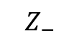
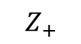
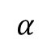
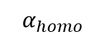
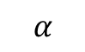
$$α$$
$$α_{homo}$$
0
s
N
s = N
$$α$$
$$Z_{+}$$
$$Z_{−}$$
s = 0

